Slide 1
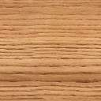










Binary
bbb
D
Algorithm
Of
Merge
Sorting
&
Time –
Complexity
What
is
Merge
Sort ?
&
Why
Using
It ?
Implementation
Of
Merge
Sorting
in C++
“Assalamu Alaikum”
C
Merge Sorting & Time-Complexity
B
ID: 1664(B)
Name: Sayed MD. Sadik Iqbal Akil
Course : Algorithm Design & Analaysis
Date: 21 March, 2022.
D
A
Submitted to Minhaz Hossain
Professor of CSE dept.

Slide 2


Merge sort algorithm uses the “divide and conquer” strategy wherein we
divide the problem into subproblems and solve those subproblems individually.
These subproblems are then combined or merged together to form a unified
solution.

Slide 3
Merge sort is performed using the following steps:
#1) The list to be sorted is divided into two arrays of equal length by dividing the
list on the middle element.
If the number of elements in the list is either 0 or 1, then the list is considered
sorted.
#2) Each sublist is sorted individually by using merge sort recursively.
#3) The sorted sublists are then combined or merged together to form a complete
sorted list.

Slide 4
General Algorithm :
The general pseudo-code for the merge sort technique is given below :
Declare an array Arr of length N If N=1, Arr is already sorted If N>1, Left = 0, right = N-1 Find middle = (left + right)/2 Call merge_sort(Arr,left,middle) => sort first half recursively Call merge_sort(Arr,middle+1,right) => sort second half recursively Call merge(Arr, left, middle, right) to merge sorted arrays in above steps. Exit;
As shown in the above pseudo code, in merge sort algorithm we divide the array into half and sort each half using merge sort recursively. Once sub-arrays are sorted individually, the two sub-arrays are merged together to form a complete sorted array.

Slide 5
Pseudo Code For Merge Sort :
Following is the pseudo code for merge sort technique. At First, we have a procedure merge sort to split the array into halves recursively. Then we have a merge routine that will merge the sorted smaller arrays to get a complete sorted array :
procedure mergesort( array,N ) array – list of elements to be sorted N – number of elements in the list begin if ( N == 1 ) return array var array1 as array = a[0] ... a[N/2] var array2 as array = a[N/2+1] ... a[N] array1 = mergesort(array1) array2 = mergesort(array2) return merge( array1, array2 ) end procedure procedure merge(array1, array2 ) array1 – first array array2 – second array begin var c as array while ( a and b have elements ) if ( array1[0] > array2[0] ) add array2 [0] to the end of c remove array2 [0] from array2
else
add array1 [0] to the end of c
remove array1 [0] from array1
end if
end while
while ( a has elements )
add a[0] to the end of c
remove a[0] from a
end while
while ( b has elements )
add b[0] to the end of c
remove b[0] from b
end while
return c
end procedure

Slide 6
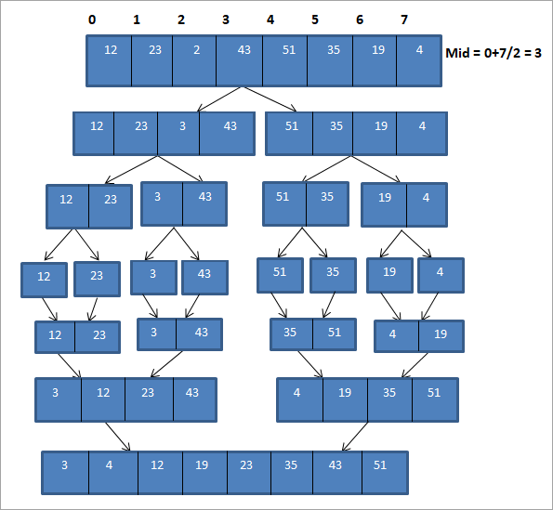
Let us now illustrate the merge sort technique with an example :

Slide 7
The above illustration can be shown in a tabular form below :
Pass | Unsorted list | divide | Sorted list
1 | {12, 23,2,43,51,35,19,4 } | {12,23,2,43} {51,35,19,4} | {}
2 | {12,23,2,43} {51,35,19,4} | {12,23}{2,43} {51,35}{19,4} | {}
3 | {12,23}{2,43} {51,35}{19,4} | {12,23} {2,43} {35,51}{4,19} | {12,23} {2,43} {35,51}{4,19}
4 | {12,23} {2,43} {35,51}{4,19} | {2,12,23,43} {4,19,35,51} | {2,12,23,43} {4,19,35,51}
5 | {2,12,23,43} {4,19,35,51} | {2,4,12,19,23,35,43,51} | {2,4,12,19,23,35,43,51}
6 | {} | {} | {2,4,12,19,23,35,43,51}
As shown in the above representation, first the array is divided into two sub-arrays of length 4. Each sub-array is further divided into two more sub arrays of length 2. Each sub-array is then further divided into a sub-array of one element each. This entire process is the “Divide” process.

Slide 8
The algorithm or technique of merge sort we have seen above uses
recursion. It is also known as “recursive merge sort”.
Given below is an implementation of merge sort technique using C++.
#include <iostream>
using namespace std;
void merge(int *,int, int , int );
void merge_sort(int *arr, int low, int high){
int mid;
if (low < high){
//divide the array at mid and sort independently using merge sort
mid=(low+high)/2;
merge_sort(arr,low,mid);
merge_sort(arr,mid+1,high);
//merge or conquer sorted arrays
merge(arr,low,high,mid);
}
}
}

Slide 9
// Merge sort
void merge(int *arr, int low, int high, int mid){
int i, j, k, c[50];
i = low;
k = low;
j = mid + 1;
while (i <= mid && j <= high) {
if (arr[i] < arr[j]) {
c[k] = arr[i];
k++;
i++;
}
else {
c[k] = arr[j];
k++;
j++;
}
}
while (i <= mid) {
c[k] = arr[i];
k++;
i++;
}
while (j <= high) {
c[k] = arr[j];
k++;
j++;
}
for (i = low; i < k; i++) {
arr[i] = c[i];
}
}

Slide 10
// read input array and call mergesort
int main()
{
int myarray[30], num;
cout<<"Enter number of elements to be sorted:";
cin>>num;
cout<<"Enter "<<num<<" elements to be sorted:";
for (int i = 0; i < num; i++) { cin>>myarray[i];
}
merge_sort(myarray, 0, num-1);
cout<<"Sorted array\n";
for (int i = 0; i < num; i++)
{
cout<<myarray[i]<<"\t";
}
}
Output:
Enter the number of elements to be sorted:10
Enter 10 elements to be sorted : 101 10 2 43 12 54 34 64 89 76
Sorted array:
2 10 12 34 43 54 64 76 89 101

Slide 11
Complexity Analysis Of The Merge Sort Algorithm :
Worst case time complexity | O(n*log n)
Best case time complexity | O(n*log n)
Average time complexity | O(n*log n)
Space complexity | O(n)
END

Slide 12


Thanks For Your Valuable Time
Creator : sm_akil

